Slide 1

transmission of text messages from sender to receiver by CHATTING APPLICATION
JAVA PROJECT
COURSE CODE:CSE310
TITLE:

Slide 2
Contents:
INTRODUCTION
TYPES
OBJECTIVES
ADVANTAGES
SCOPE OF PROJECT
FUTURE OF PROJECT
CONCLUSION

Slide 3

INTRODUCTION
Chatting applications have become an integral part of our daily lives. With the rise of smartphones and internet connectivity, people are using chatting applications more than ever before. These applications allow users to communicate with each other in real-time, regardless of their location.
This client server chat application is based on java swing and used socket package. its simple and easy and require only core java knowledge. I have taken this program from internet and modified a little bit to make it simpler and more elegant.

Slide 4

Types of Chatting Applications
There are several types of chatting applications available today, including social media messaging apps, team communication apps, and video conferencing apps. Social media messaging apps like WhatsApp, Facebook Messenger, and WeChat allow users to chat with friends and family members, share photos and videos, and make voice and video calls.

Slide 5
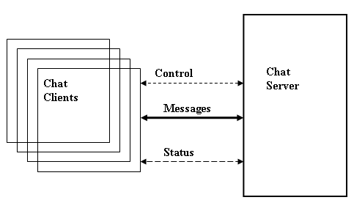
OBJECTIVES
The aim of this project is to express how we can implement a simple chat application between a server and a client? The application is a desktop based application and is implemented using Swing and awt. The project is developed in Java SE language executed on a single stand-alone java across a network using loop back address concept.
Application consists of two programs:
Server
Client

Slide 6
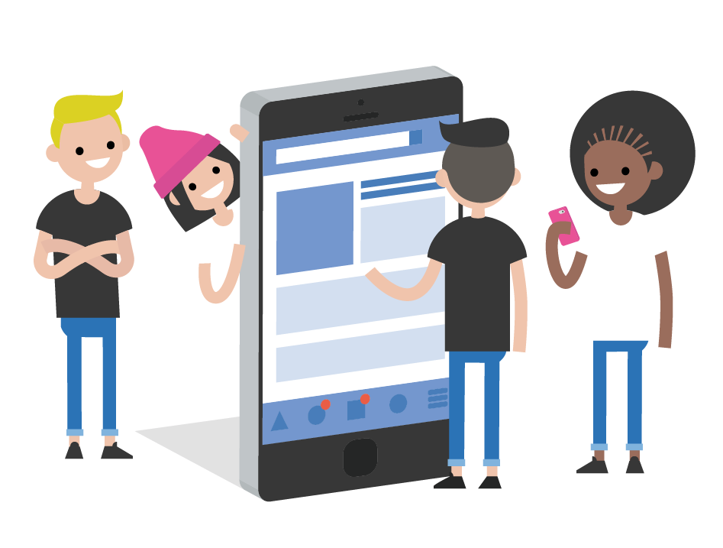
Advantages of Chatting Applications
Chatting applications offer numerous advantages over traditional methods of communication. One of the biggest advantages is that they allow users to communicate in real-time, making it easier to stay in touch with friends, family, and colleagues. They also provide a platform for sharing multimedia content, such as photos and videos, which can help enhance communication and make conversations more engaging.

Slide 7
SCOPE OF PROJECT
Server
A server is a computer program that provides services to other computer programs (and their users) in the same or other computers. The computer that a server program runs in is also frequently referred to as a server. That machine may be a dedicated server or used for other purposes as well. Example Server, Database, Dedicated, Fileserver, Proxy Server, Web Server. The server is always waiting for client’s requests. The client come and go down but the server remains the same.

Slide 8
Client
On the client site the client knows the hostname of the machine on which the server is running and the port number on which the server is listening.
To make a connection request, the client tries to rendezvous with the server on the server's machine and port. The client also needs to identify itself to the server so it binds to a local port number that it will use during this connection. This is usually assigned by the system.

Slide 9

Future of Chatting Applications
There is always a room for improvements in any software package, however good and efficient it may be done. But the most important thing should be flexible to accept further modification. Right now we are just dealing with text communication. In future this software may be extended to include features such as:
Files transfer: this will enable the user to send files of different formats to others via the chat∙ application.
Voice chat: this will enhance the application to a higher level where communication will be∙ possible via voice calling as in telephone.
Video chat: this will further enhance the feature of calling into video communication.∙

Slide 10
Conclusion
I Developed network applications in Java by using sockets, threads, and Web services.
These software is portable, efficient, and easily maintainable for large number of clients. Our developed web-based chatting software is unique in its features and more importantly easily customizable. The java.net package provides a powerful and flexible set of classes for implementing network applications. Typically, programs running on client machines make requests to programs on a server Machine. These involve networking services provided by the transport layer. The most widely used transport protocols on the Internet are TCP (Transmission control Protocol) and UDP (User Datagram Protocol).

Slide 11


